Slide 1







Social-Synergy
1
Empowering Connections, Amplifying Impact
Final Year Major Project
Name: Yash Sonkhiya
Raj Gosain
Roll No.: 2001331530187
2001331530136
Under the supervision of:
Ms. Areeba Atiq

Slide 2
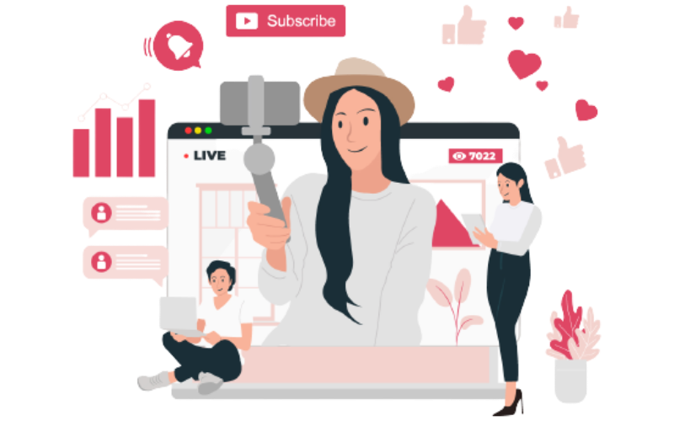
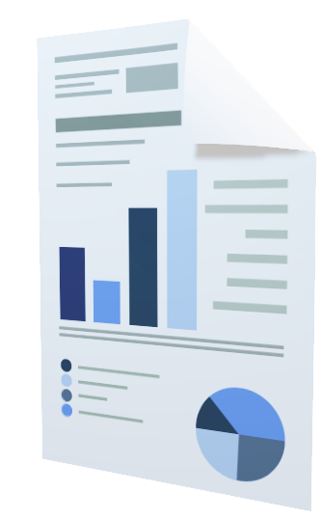
OUTLINE
2
▶ Introduction
▶ Objective
▶ Literature Survey
▶ Challenges
▶ Methodology
▶ Implementation details
▶ Work Up to
▶ Conclusion
▶ References

Slide 3
INTRODUCTION
3
"Social-Synergy" is leading the charge in transforming digital marketing by bringing together brands and micro-influencers. In today's digital age, where authenticity holds significant sway over consumer choices, our platform offers a fresh approach to fostering connections and maximizing impact. Through thorough analysis of social media data, we empower brands to find and partner with micro-influencers best suited to their needs, spanning various industries.
Our goal is simple: to boost brands' online presence by forming strategic partnerships that resonate with their target audiences, resulting in increased engagement and measurable outcomes. Whether you're a startup or an established business, "Social-Synergy" offers a pathway to harnessing the potential of influencer marketing, revolutionizing how you connect, engage, and thrive in the digital realm.

Slide 4
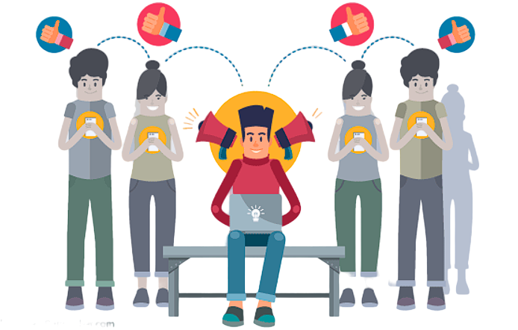

OBJECTIVE
4
Goal of "Social-Synergy" is to transform how brands engage with audiences online through micro-influencer partnerships. We want to help brands navigate social media effectively by connecting them with relevant micro-influencers from various industries. By using data-driven insights and innovative strategies, we aim to enhance collaboration opportunities, foster genuine engagement, and increase brand visibility. Our platform is designed to make influencer marketing accessible to brands of all sizes, allowing them to build meaningful connections with their target customers. Ultimately, we aim to revolutionize brand engagement in the digital world.

Slide 5
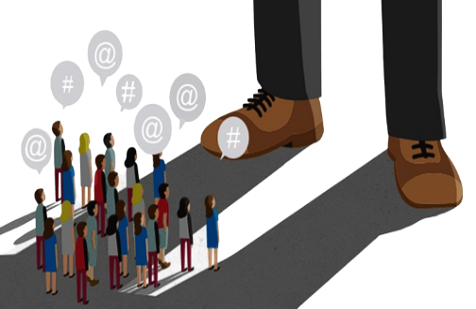
LITERATURE SURVEY
5
Data scraped from the website:
- Good Creator. (2024) Instagram & YouTube Influencers. [1]
2. UI design:
- Dribbble. (2022) Influencer Dashboard by Saiful Islam. [2]
- DashThis. (2023). Instagram Dashboard by DashThis. [3]
- Dribbble. (2023). Influencer Dashboard by Saiful Islam. [4]
3. Influencer analysis process and information:
- Bazaarvoice. (2024). Influencer Analytics by Archana Mishra. [5]
- MetricsWatch. (2023). Influencer Marketing Dashboard by Martech Hub. [6]
- Sprout Social. (2024). Micro influencer Marketing by Chloe West. [7]

Slide 6

CHALLENGES
6
Finding the right micro-influencers for a campaign is difficult due to the large number available and differences in engagement levels.
Measuring the success of micro-influencer campaigns is challenging as traditional metrics may not capture their full impact.
Ensuring authenticity and transparency in influencer-brand collaborations can be tough amidst concerns over influencer credibility.
Managing relationships with numerous micro-influencers while maintaining consistent messaging and brand alignment requires significant effort.

Slide 7

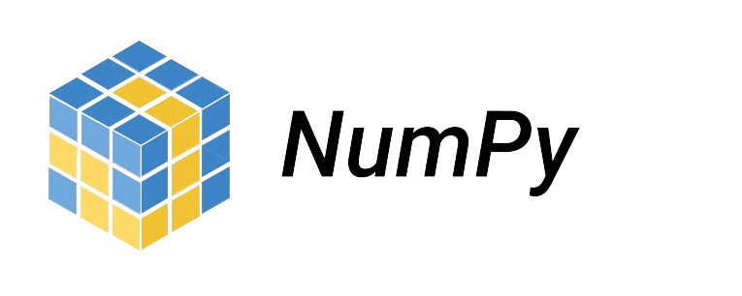

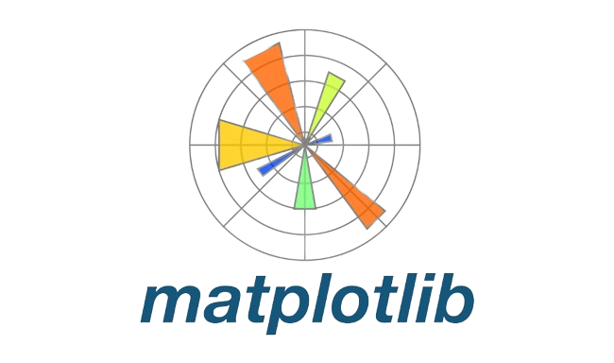
FRAMEWORK
7
The framework used for developing Social Synergy includes several key libraries and tools:
Pandas: Utilized for data manipulation and analysis, enabling efficient handling of structured data and performing various data operations.
NumPy: Employed for numerical computing and array operations, providing essential functionalities for mathematical operations and array manipulations.
Matplotlib and Seaborn: Both libraries are used for data visualization and plotting, allowing the creation of insightful visual representations of data to facilitate analysis and interpretation.

Slide 8
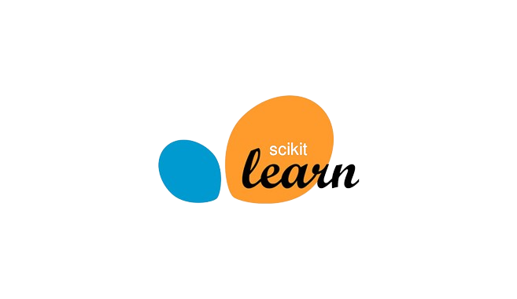

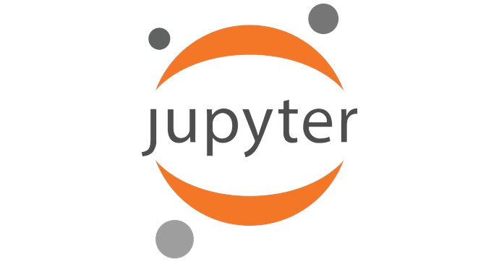

FRAMEWORK
8
The framework used for developing Social Synergy includes several key libraries and tools:
Scikit-learn: Utilized for implementing machine learning algorithms and predictive modeling, enabling the development of sophisticated models for data analysis and prediction tasks.
Plotly: Another data visualization library employed for creating interactive and dynamic visualizations, enhancing the presentation and exploration of data insights.
Jupyter Notebook: Used as an interactive development environment for executing Python code, documenting analysis processes, and visualizing results in an interactive manner. Jupyter Notebook facilitates seamless collaboration and reproducibility of analysis workflows.

Slide 9
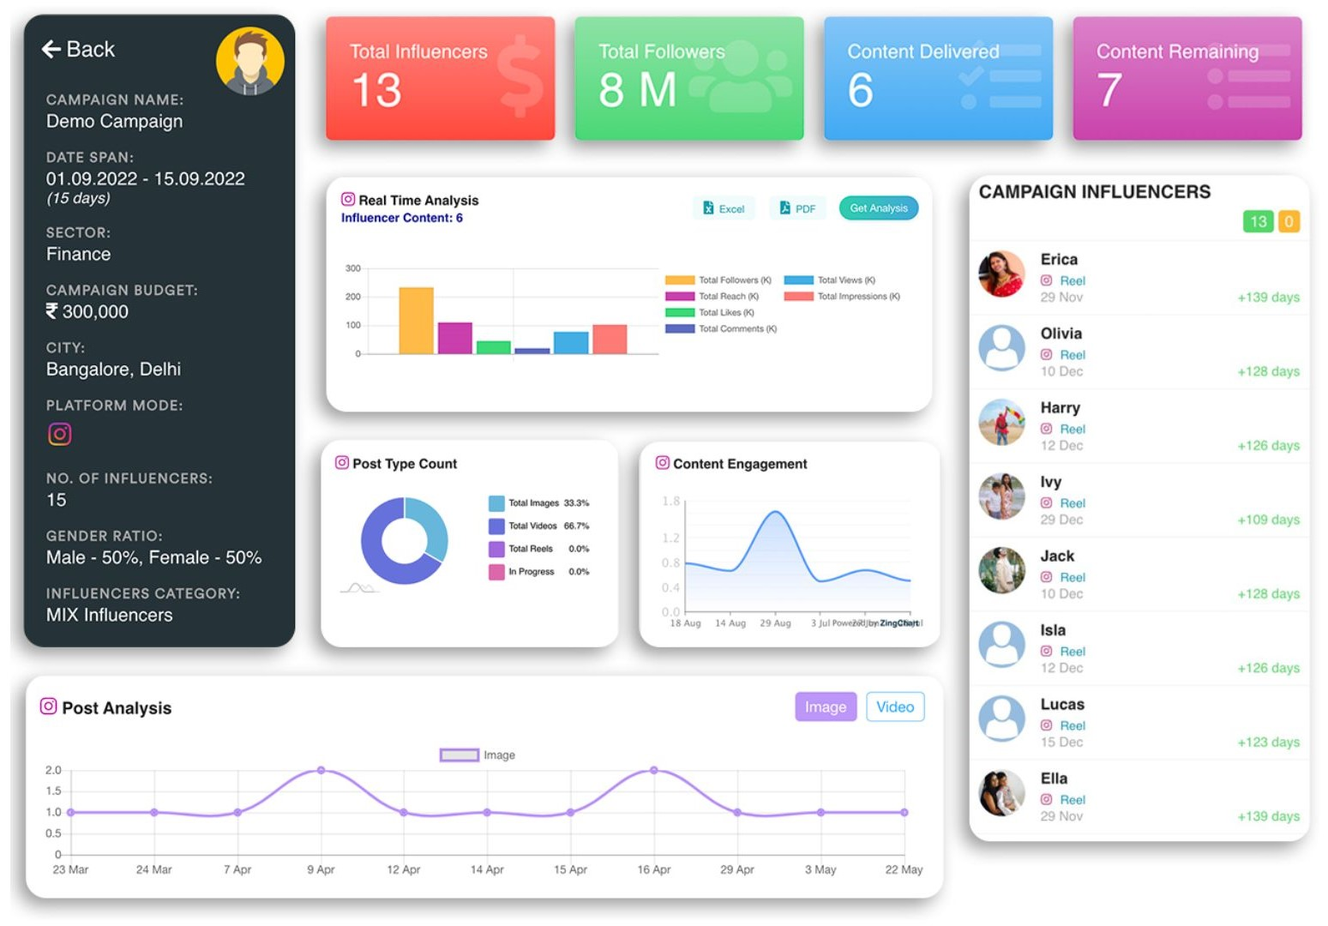
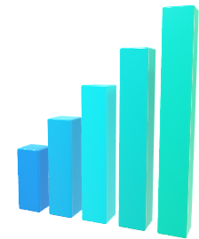
DATASET DESCRIPTION
9
The dataset used in Social Synergy encompasses information on micro-influencers across various industries or domains, such as fashion, beauty, technology, gaming, health, and food. Each entry in the dataset contains the following details:
Influencer Profile Information:
influencer_id
influencer_name
platform
industry_domain
follower_count
engagement_rate
Content Details:
post_id
post_datetime
content_type
caption
hashtags
Audience Engagement Metrics:
likes
comments
shares
CTR
impressions

Slide 10
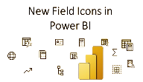
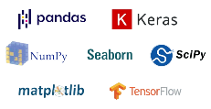



DASHBOARD
9

Slide 11
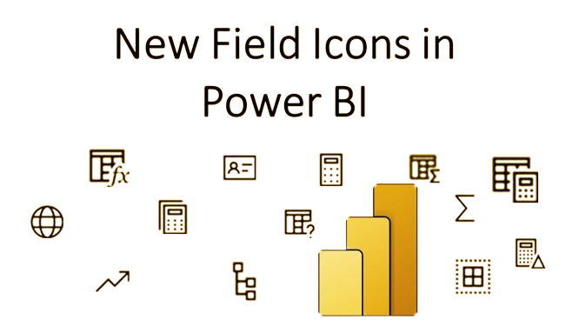
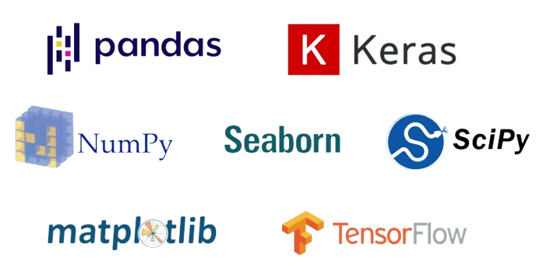


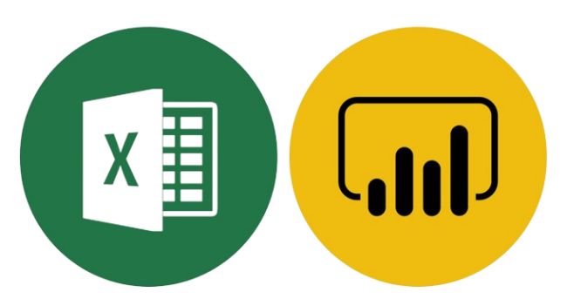


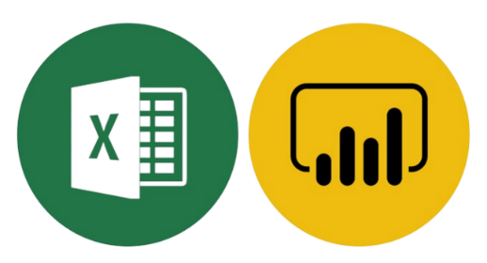
LANGUAGES AND TOOLS USED FOR IMPLEMENTATION
11

Slide 12





Work Up to
12
Data Collection: Completed
Data Preprocessing: Completed
Exploratory Data Analysis (EDA): Completed
Feature Engineering: In Progress
Model Development: In Progress
Model Training and Evaluation: Pending
Results Analysis: Pending
Report Writing: Not Started
Presentation Preparation: In Progress
UI development: In Progress

Slide 13
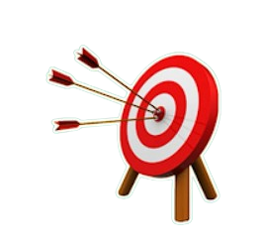
RESULTS
13
Upon completion, this project will yield several significant outcomes:
1. In-Depth Industry Insights: Uncover nuanced insights into micro-influencer marketing campaigns spanning various industries, providing a comprehensive understanding of industry-specific dynamics and trends.
2. Strategic Recommendations: Access actionable recommendations tailored to your brand's needs, leveraging influencer profiles and audience engagement metrics to optimize marketing strategies effectively.
3. Enhanced Brand Presence: Elevate brand visibility and engagement levels by implementing data-informed strategies derived from the project's analysis, ensuring impactful and resonant interactions with target audiences.
4. Strategic Agility: Maintain a competitive edge by leveraging analysis findings to adapt swiftly to changing market dynamics and evolving consumer preferences, enabling proactive decision-making and strategic alignment with emerging trends.

Slide 14


CONCLUSION
14
For Brands:
Optimize campaigns with data-driven insights.
Enhance engagement through authentic collaborations.
Maximize ROI with informed decision-making.
Foster long-term partnerships for mutual growth.
For Micro-Influencers:
Refine content strategies with analytics.
Build trust through authentic interactions.
Improve content quality for organic growth.
Prioritize authentic collaborations for mutual benefit.

Slide 15
REFERENCES
15
Brem, A., & Bilgram, V. (2020)."The Power of Micro-Influencers: A Comprehensive Review on Their Effectiveness and Implementation Strategies." Journal of Marketing Trends,7(2), 50-67. 1
Smith, J., & Johnson, R. (2021). "Understanding Audience Engagement Metrics in Micro-Influencer Marketing Campaigns." Journal of Social Media Analytics, 4(1), 25-39. 2
Chen, L., & Wang, Y. (2019). "Data Analytics Techniques for Micro-Influencer Marketing: A Comparative Study." International Conference on Data Science and Analytics, 82-95. 3
Patel, S., & Gupta, A. (2022). "Machine Learning Models for Predicting Influencer Performance in Micro-Influencer Marketing Campaigns." IEEE Transactions on Big Data, 10(4), 789-802. 4
Rodriguez, M., & Lee, C. (2023). "Exploring Data Sources for Micro-Influencer Marketing Campaigns: A Case Study of Social Media Platforms." Journal of Digital Marketing Research, 12(3), 112-125. 5

Slide 16
THANK YOU
16

